Slide 1
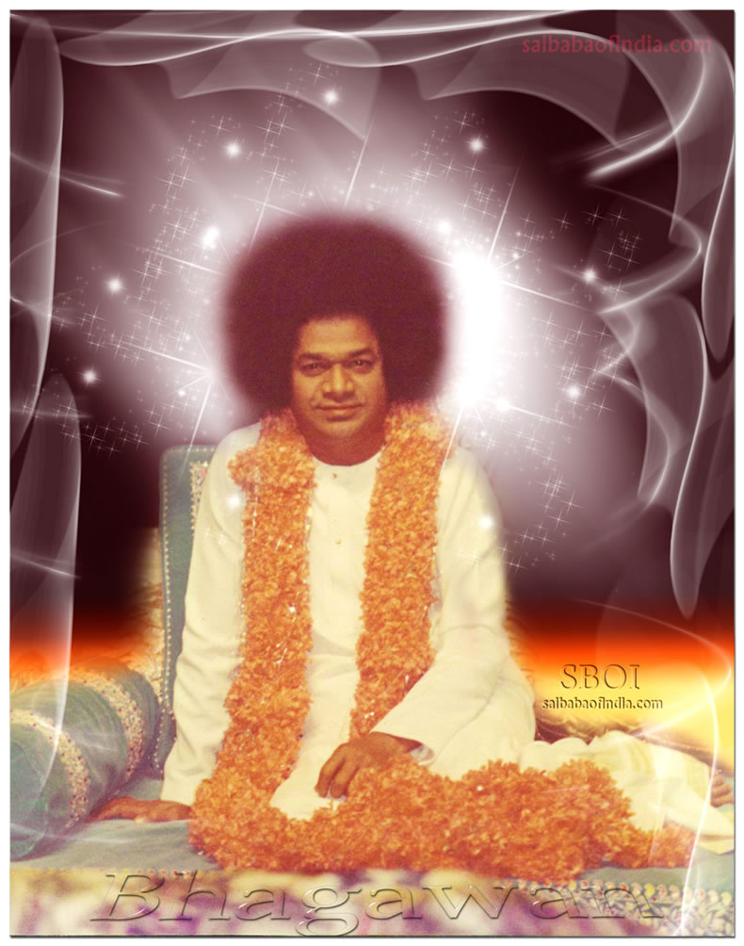
Offering My most humble pranams at the lotus feet of my Divine Mother Sai.

Slide 2
A Study of Certain Motion Estimation Algorithms
V.Sai Krishna
18565 , II M.Tech.(C.S)
Department of Mathematics And Computer Science (DMACS)
Project Guide :
Dr. N. Uday Kiran

Slide 3
Introduction
Image Processing of certain problems arising in the field of Medical Imaging.
Our main interest is working on Cardiac Imaging problems.
Two part work :
Building a module in the 3D Slicer (20%)
Motion Estimation from a sequence of images (80%)

Slide 4
Two Part Work
Development of 2 Modules in 3D Slicer
3D Image Brightness Threshold Module
3D Volumetric Image Segmentation Module
Optical Flow Estimation
2D and 3D Horn and Schunck Optical Flow Estimation.
2D and 3D William Harvey Code Optical Flow Estimation.
Improving a Horn-Schunck based CNN LiteFlowNet(2018) for various datasets.
Re-adapting LiteFlowNet model for fluid based motion estimation.

Slide 5
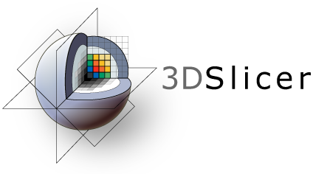
The Open Source Software - 3D Slicer
An important Medical Imaging tool.
Facilities to work with medical image data like DICOM format data, MRML format data, etc.

Slide 6
Medical Image Processing using 3D slicer
Libraries used : VTK, QT, CTK, SLICER
Development of 2 Modules in 3D Slicer
3D Image Brightness Threshold Module
3D Volumetric Image Segmentation Module

Slide 7
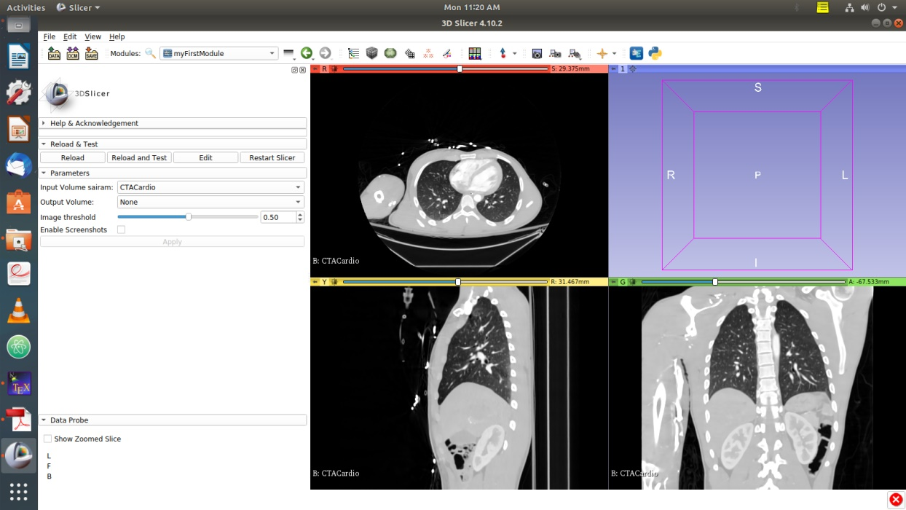
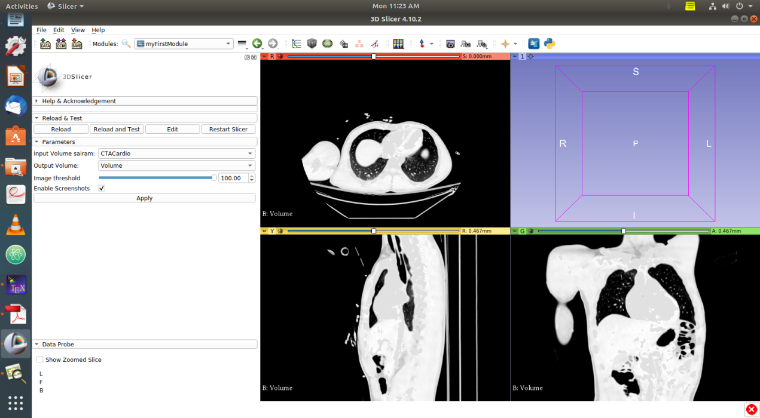
3D Image Brightness Threshold Module
Before Increasing the Brightness of the CTACardio Image using the Module
After setting the Brightness to the maximum of the CTACardio Image using the Module

Slide 8
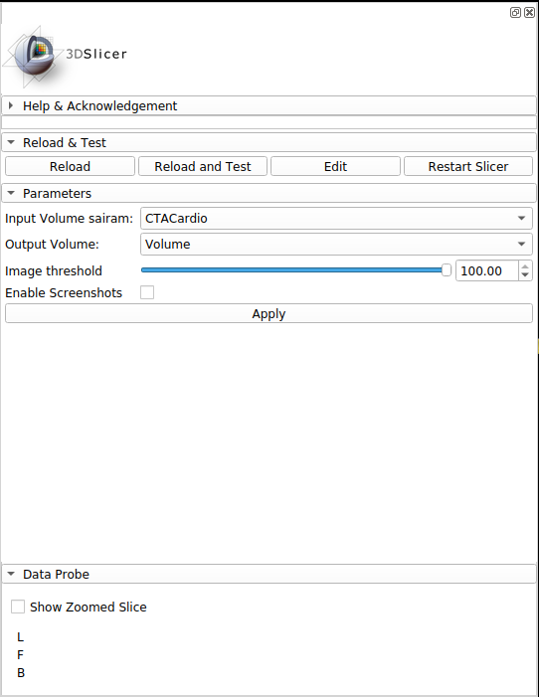
Brightness Threshold Module GUI

Slide 9
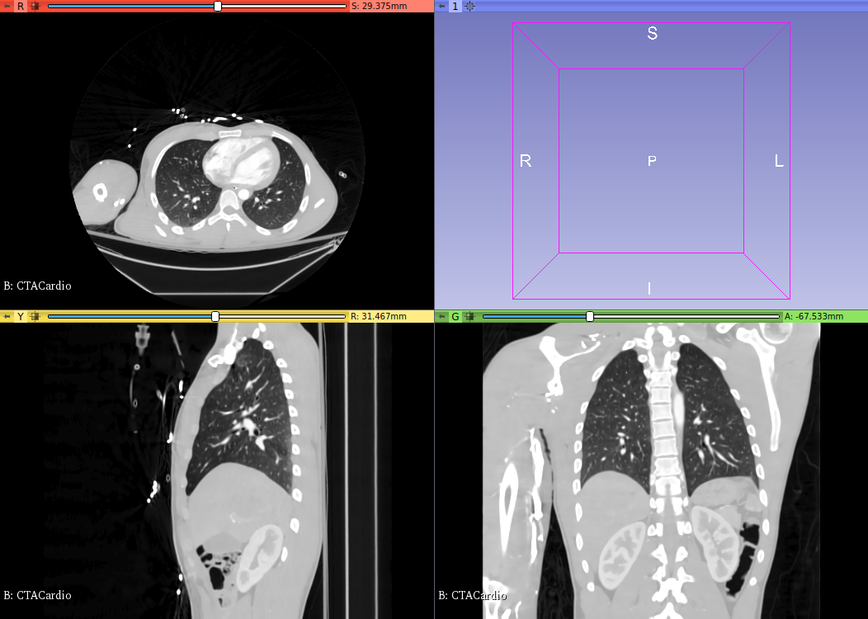
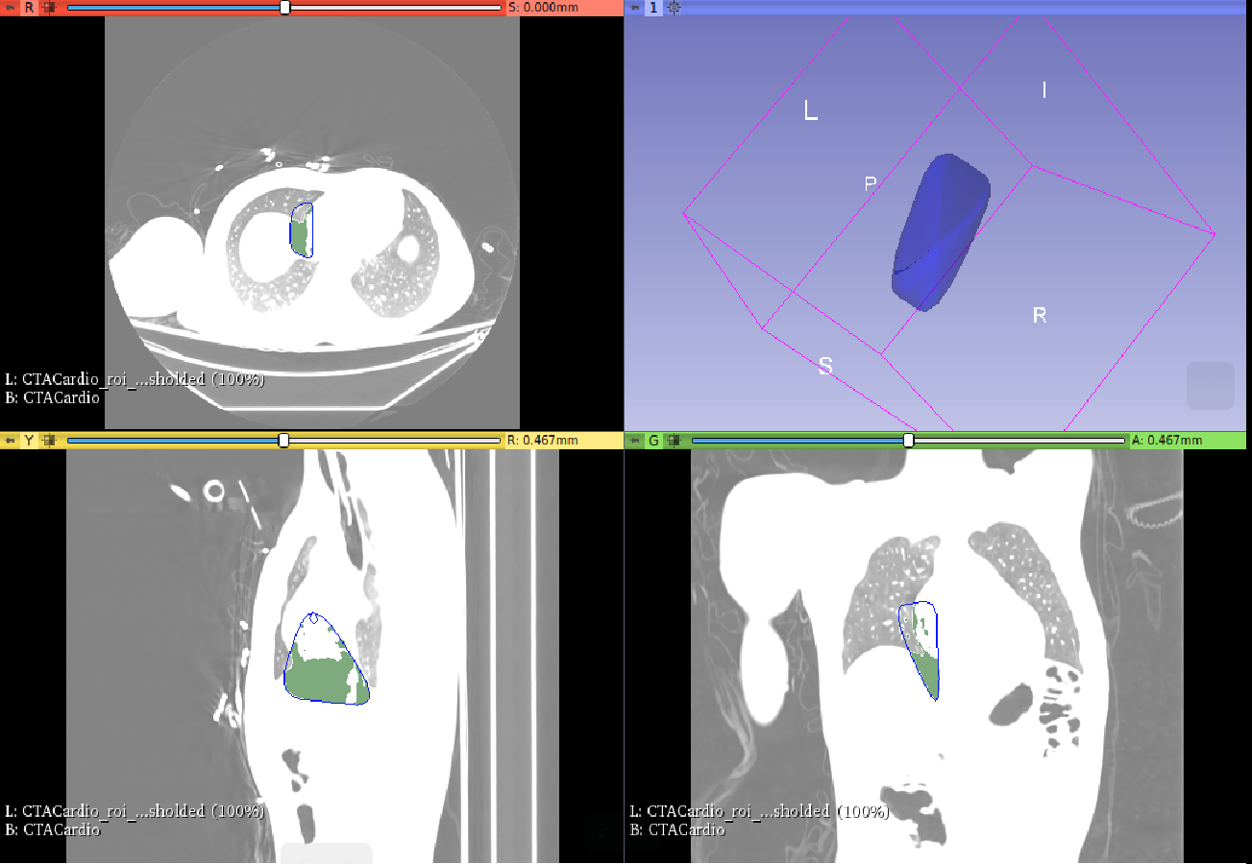
3D Volumetric Image Segmentation Module (Reference module : SlicerRT)
Before Segmenting any region using the Module
Region Of Interest(ROI) is being shown after segmenting using the Module

Slide 10
Motion Estimation Approaches
Direct or Pixel based Methods
Block – Matching Algorithms
Phase Correlation and Frequency Domain methods
Pixel Recursive Algorithms
Optical Flow
Direct Methods match corresponding pixels between image frames.
Indirect or Feature based Methods
Corner Detection
Indirect Methods match corresponding features between image frames.

Slide 11
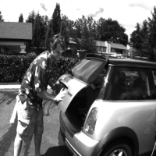

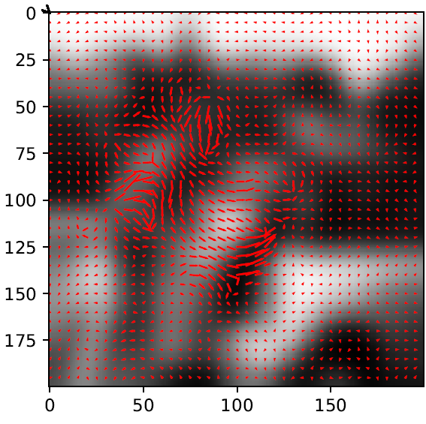
What is Optical Flow?
Image frame1
Image frame2
Arrows based Optical Flow Ouput

Slide 12

What is Optical Flow?
Image frame1
Image frame2
Colour Coded Optical Flow Ouput

Slide 13
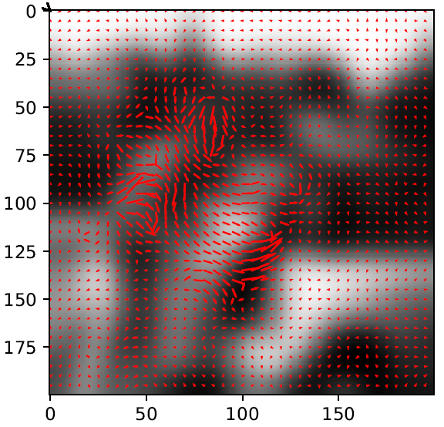
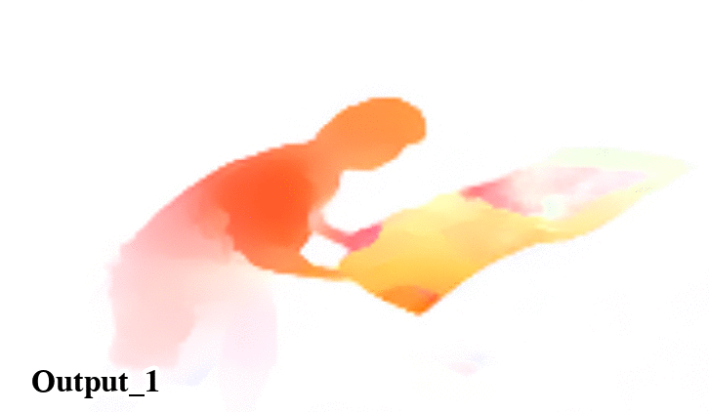
Optical Flow Outputs
Arrows based Optical Flow Ouput
Colour Coded Optical Flow Ouput

Slide 14
Applications of Motion Estimation
Tracking and Surveillance of moving objects
Robotics
Medical Imaging
Image Sequence Analysis
Object Detection
Detection of fluid flow motion and direction
Video Compression
Movement Detection

Slide 15
Optical Flow
One of the famous methods for motion estimation is the generation of Optical Flow.
Optical flow helps us to detect and estimate the pattern of motion for rigid bodies.
Variational Calculus based approach - Horn and Schunck method (1981)
Learning based approach - CNN LiteFlowNet (2018)
We have attempted to build a learning based approach for determining the optical flow of a fluid based image sequence.

Slide 16
Cardiac Motion Estimation Constraints
Optical Flow Constraint (also called as Rigid Body Motion Constraint Equation)
Smoothness Constraint (Introduced by Horn and Schunck Method)
Geometric Constraint (Introduced by William Harvey Code Method)
Fluid based Constraint (Through Continuity Equation in Fluid Dynamics)

Slide 17
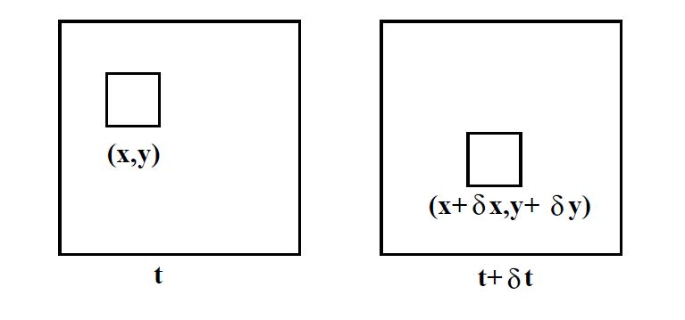
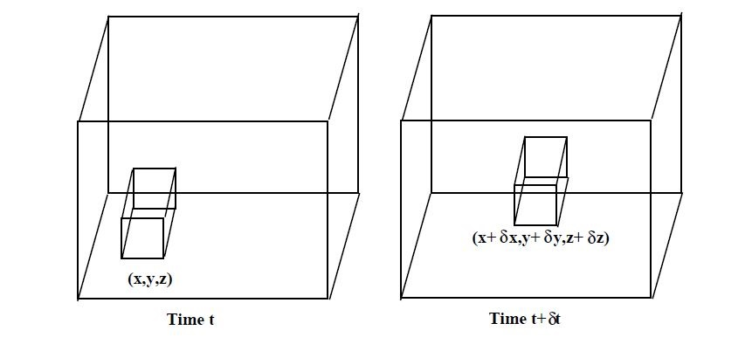
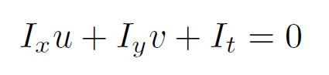
Point to Point Correspondence in Optical Flow Estimation
Optical flow captures pixel/voxel motion between time adjacent image frames.

Slide 18
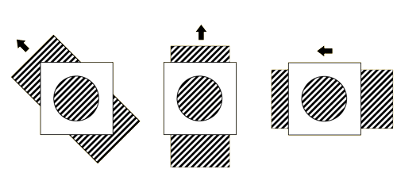
Aperture problem
Aperture Problem is an Ill-Posed Problem with One Equation and Two Unknowns.

Slide 19
Horn and Schunck Optical Flow Estimation (1981)
Incorporated Smoothness Constraint (SC) to the existing Optical Flow Constraint (OFC).
Horn and Schunck Optical Flow Estimation Method is based on the following assumptions :
1. Brightness Constancy
2. Spatial Coherence
3. Temporal Persistence
4. Flow Smoothness over the entire image
5. Small motion

Slide 20
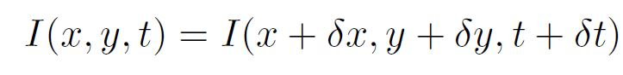
2D Optical Flow Equation
One Equation 2 unknowns : ILL POSED PROBLEM.
Horn and Schunck(1981) have introduced an additional Smoothness Constraint (SC) to the existing Optical Flow Constraint (OFC) to solve the 2D Optical Flow Equation equation

Slide 21
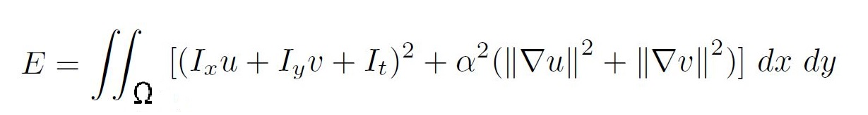
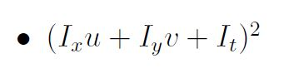
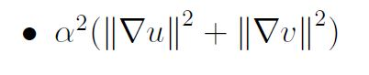
2D Horn and Schunck Energy Functional
2D Optical Flow Constraint (OFC) or 2D Motion Constraint
(MC)
Smoothness Constraint(SC) or
Horn and Schunck Optical Flow Constraint (HS-OFC)

Slide 22
Datasets
Middlebury Datasets (used in Horn and Schunck and WHC implementation)
Sintel Dataset (pre-trained LiteFlowNet models)
KITTI 2012 , 2015 Datasets (pre-trained LiteFlowNet models)
Particle Image Velocimetry (PIV) Dataset.
Waterflow Image Frames by Sri Hirak Doshi
898 images of Horn and Schunck (Input) and corresponding Continuity Equation (Label) based Optical Flows generated by Sri Hirak Doshi.

Slide 23


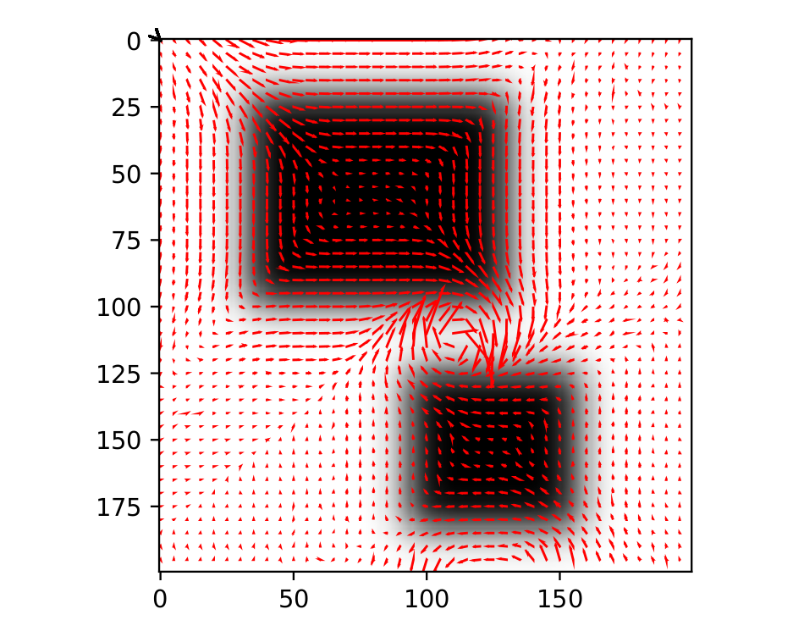
Horn and Schunck 2D Output
2D Image frame1
2D Image frame2
2D HS Optical Flow

Slide 24
Horn and Schunck 3D Input
3D Image frame1
3D Image frame2

Slide 25
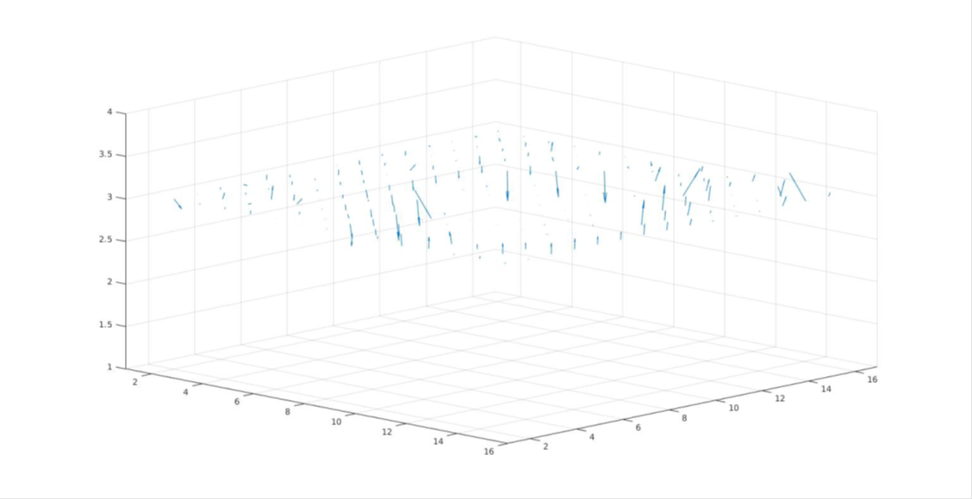
Horn and Schunck 3D Output
3D HS Optical Flow

Slide 26
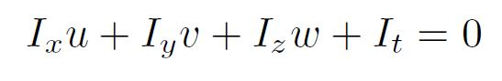
3D Optical Flow Equation
2 Equations and 3 unknowns : ILL POSED PROBLEM
Imiya and Kameda (2008) have introduced an additional Geometric Constraint (GC) to the existing Optical Flow Constraint (OFC), Smoothness Constraint(SC) to solve the 3D Optical Flow Equation.

Slide 27
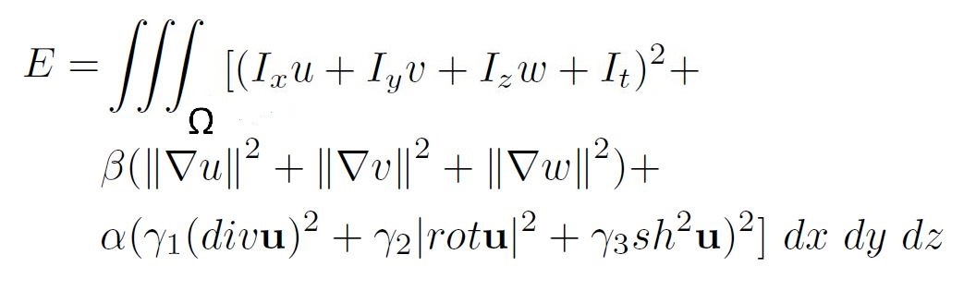
3D William Harvey Code Energy Functional
Constraints : (motion based constraint) + (smoothness constraint) + (geometric constraint)

Slide 28
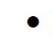
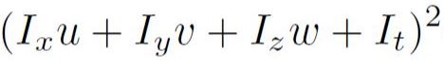
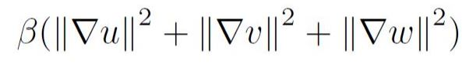
3D William Harvey Code Optical Flow Estimation Constraints
3D Optical Flow Constraint (OFC) or
3D Motion Constraint (MC)
3D Smoothness Constraint(SC) or
3D Horn and Schunck Optical Flow Constraint (HS-OFC)
3D Geometric Constraint(GC) or
3D Nagel Enkelmann
Optical Flow Constraint (NE-OFC)

Slide 29
William Harvey Code 2D output
2D WHC Optical Flow

Slide 30
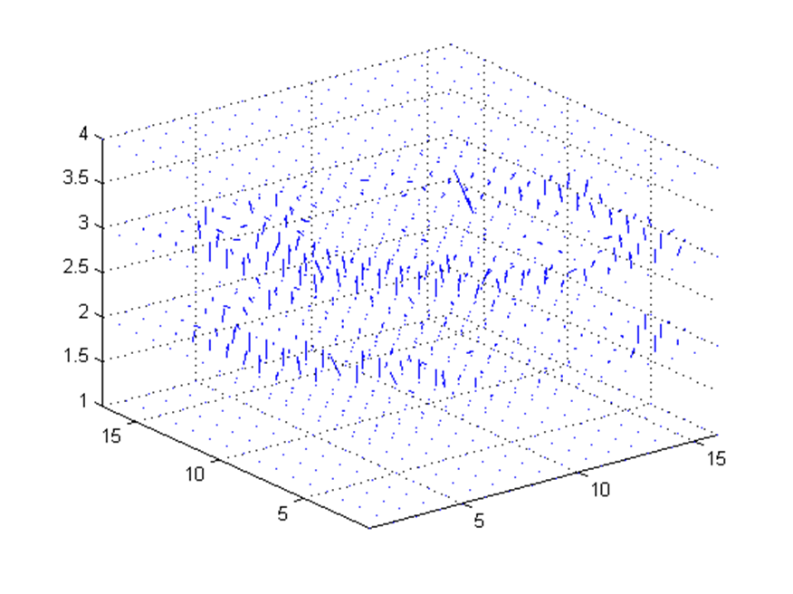
Comparision of 3D Outputs
Horn and Schunck
William Harvey Code

Slide 31
Deep Learning for Optical Flow Estimation
Convolutional Neural Networks(CNNs) have outperformed conventional optical flow estimation methods.
Improvements to LiteFlowNet(2018) by C.C.Loy et.al., to work on Particle Image Velocimetry (PIV) datasets.
Adding an extra layer to LiteFlowNet, to generate fluid-flow based optical flow output.

Slide 32
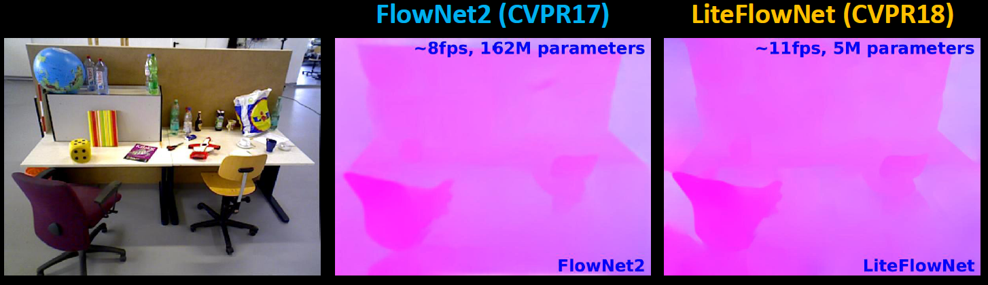
LiteFlowNet: A Light weight Convolutional Neural Network for Optical Flow Estimation [CVPR 2018]

Slide 33
LiteFlowNet (2018)
State of the art CNN model developed based on Horn and Schunck Method (1981), for computing 2D Optical Flow.
Cascaded Flow Inference module - HS Data Fidelity term
Regularization module - HS Regularization term
HS stands for Horn and Schunck
WHC stands for William Harvey Code
LFN stands for LiteFlowNet

Slide 34
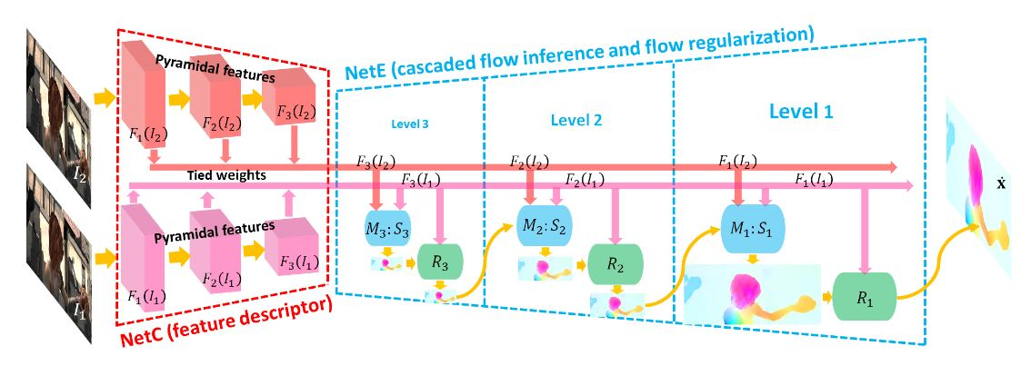
LiteFlowNet Architecture

Slide 35


LiteFlowNet Output on Box Images
Image frame1
Image frame2
LFN Optical Flow

Slide 36

LiteFlowNet Output on Sphere Images
Image frame1
Image frame2
LFN Optical Flow

Slide 37
Variational based Horn and Schunck with geometric constraint output on Sphere Images
Image frame1
Image frame2
HS with GC Optical Flow

Slide 38
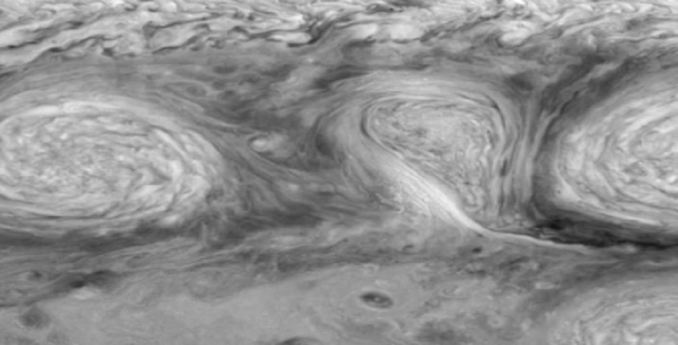
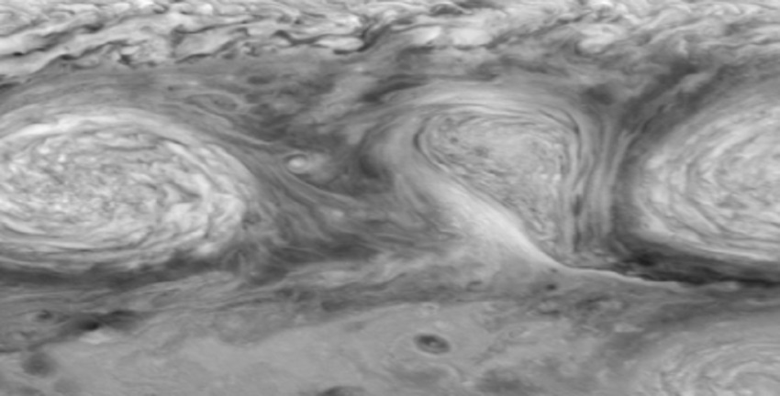

LiteFlowNet Output on PIV Images
PIV Image frame1
PIV Image frame2
LFN Optical Flow

Slide 39
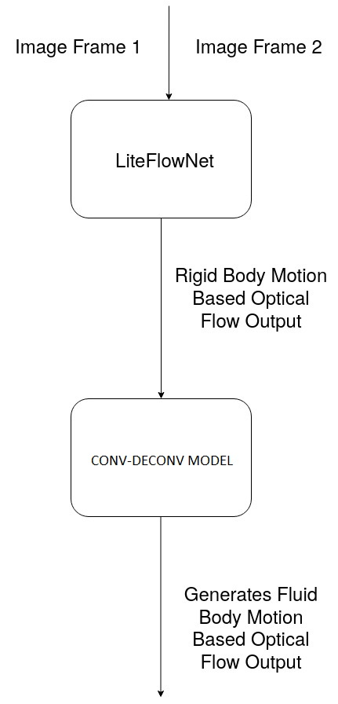


Extending LiteFlowNet to generate Fluid based Optical flow output
Waterflow Image frame1
Waterflow Image frame2

Slide 40
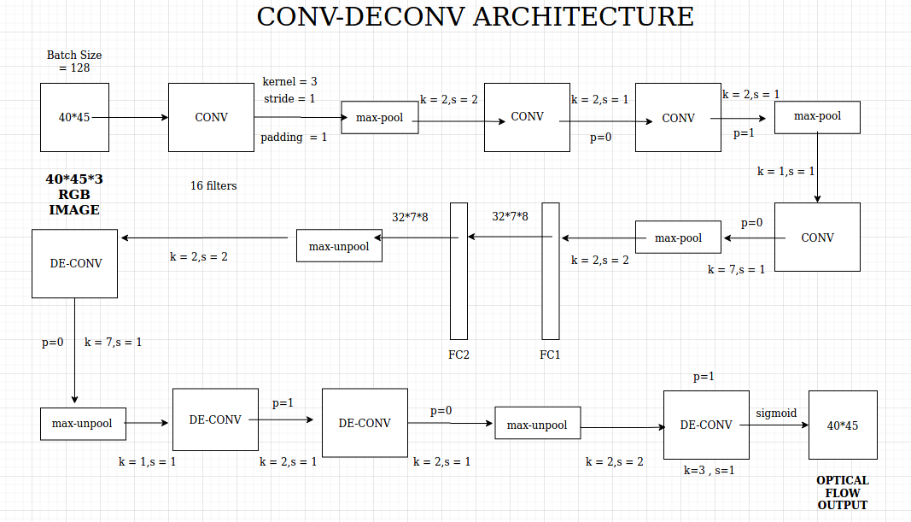

Slide 41
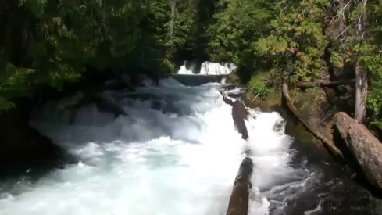
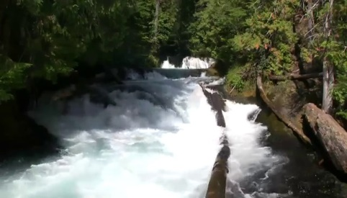
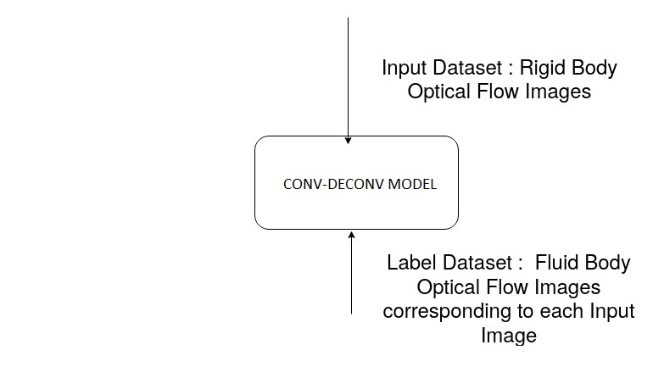


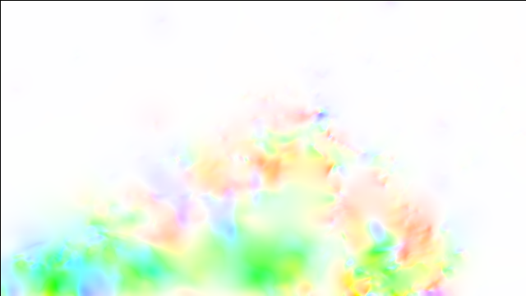

Training Phase
Rigid Body based
Flow - HS51
Fluid Body based
Flow - CE51

Slide 42
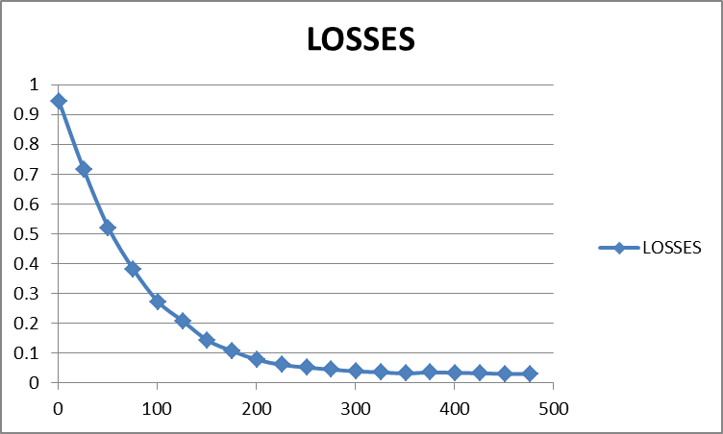
Training Losses for 500 Epochs

Slide 43
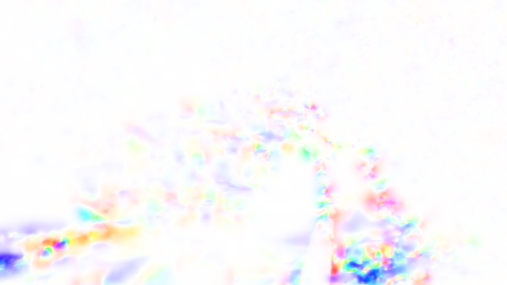
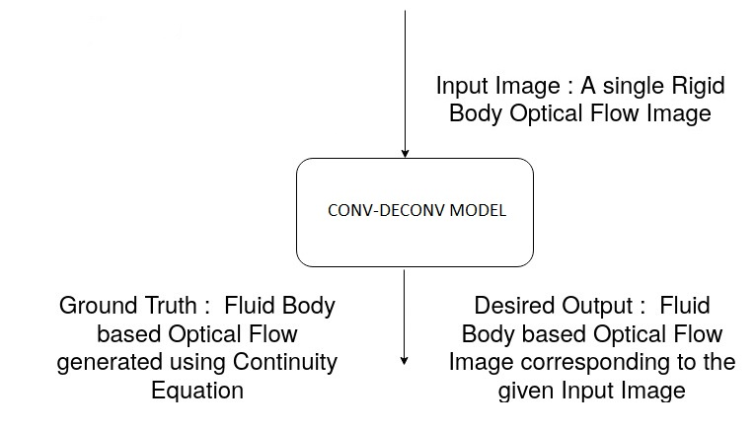
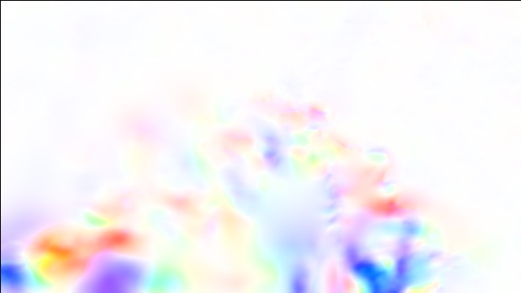

Testing Phase
IN: Rigid Body
based
Flow
LFN57
GT : Fluid based Flow
CE57
OU : Our
model
Output

Slide 44
Fluid Flow Outputs generated by LFN with an Additional Layer
Input Image
Label Image
Output Image
LiteFlowNet Optical Flow
Continuity Equation Optical Flow
(LFN + Additional Layer)
Our Model Optical Flow

Slide 45
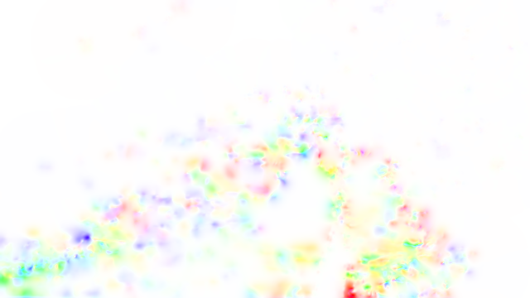
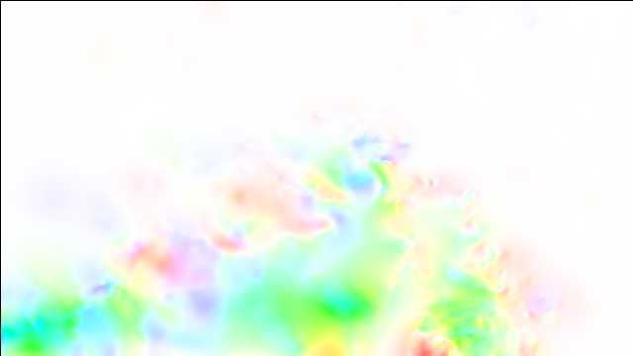

Fluid Flow Outputs generated by LFN with an Additional Layer
Input Image
Label Image
Output Image
LiteFlowNet Optical Flow
Continuity Equation Optical Flow
(LFN + Additional Layer)
Our Model Optical Flow

Slide 46
Conclusion
2 Part Work
Development of 2 Modules in 3D Slicer
3D Image Brightness Threshold Module
3D Volumetric Image Segmentation Module
Optical Flow Estimation
2D and 3D Horn and Schunck Optical Flow Estimation.
2D and 3D William Harvey Code Optical Flow Estimation.
Improving a Horn-Schunck based CNN LiteFlowNet(2018) for various datasets.
Re-adapting LiteFlowNet model for fluid based motion estimation.

Slide 47
Future Work
Accuracy and Loss reduction, Output Generation by large amounts of data.
Diversified fluid body image sources
LiteFlowNet on 3D Images
LiteFlowNet on Variational based Methods
Various types of Image Processing operations by 3D Segmentation Module

Slide 48
References
[1] B.K.P. Horn and B.G. Schunck, Determining optical flow, Artificial Intelligence,
vol 17, pp 185–203, (1981).
[2] C. Pinter, A. Lasso, A. Wang, D. Jaray, and G. Fichtinger, SlicerRT Radiation
Therapy Research Toolkit for 3D Slicer. Med. Phys., 39(10) : 6332 – 6338 (2012).
[3] H H Nagel and W Enkelmann, An investigation of smoothness constraints for the
estimation of displacement vector fields from image sequences (1986).
[4] Sri Hirak Doshi and Dr. N. Uday Kiran, The Non-linear Evolutionary PDE Approach
for Optical Flow Estimation (underpreparation) (2019).
[5] J.L.Barron and N.A.Thacker, Tutorial: Computing 2D and 3D optical flow (2005).
[6] Pengpeng Liu, Michael R. Lyu, Irwin King and Jia Xu, Selflow: Self-supervised
learning of optical flow, CVPR (2019).

Slide 49
References
[7] 3D Slicer Documentation, https://www.slicer.org/ (2012) .
[8] Simon Niklaus, A Reimplementation of LiteFlowNet using PyTorch.
https:// github.com/sniklaus/pytorch-liteflownet (2019).
[9] S.Toomey, The aperture problem. Toomey's Weblog (2008).
[10] Tak-Wai Hui, Xiaoou Tang, Chen Change Loy , CUHK-SenseTime Joint Lab, The Chinese University of Hong Kong, LiteFlowNet : A LightWeight CNN for Optical Flow Estimation, CVPR (2018).
[11] Wikipedia, the free encyclopedia, https: //en.wikipedia.org/ (2020).
[12] Yusuke Kameda and Atsushi Imiya, The William Harvey Code: Mathematical Analysis of Optical Flow Computation for Cardiac Motion , (2008).

Slide 50
Acknowledgements
Dr. N. Uday Kiran and Sri Hirak Doshi
Dr. (Mrs.) Rita Gupta, HOD, DMACS
Dr. R. Raghunatha Sarma, Associate HOD, DMACS
Sri Sai Shyam Sharma
Sri C. Uday Kiran, Sri Varun Vallampatla, Sri R. E. V. Raghuram
All the Faculty members of DMACS
All my Classmates

Slide 51
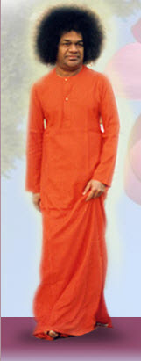
Thank You
Those who leave everything in God’s hand will eventually see God’s hand in everything.

Slide 52
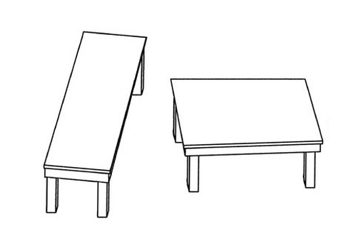
Optical Illusion

